Slide 1
PSCS385-Development of AI/ML based solution for detection of face-swap based deep fake videos
PIP4004 University Project
Review-2
Batch Number: CIT-G25
Roll Number 20211CIT0133 20211CIT0134 | Student Name MANISH RANJAN M B
20211CIT0010 | JAMPULA VISHNU VARDHAN
20211CIT0030 | SHREEJIT S SHETTY
20211CIT0138 | Harsha Vardhan P
Under the Supervision of,
Dr. Mohana SD
Professor / Associate Professor / Assistant Professor
School of Computer Science and Engineering
Presidency University
Name of the Program: Btech
Name of the HoD: Dr. S P Ananda Raj
Name of the Program Project Coordinator: Dr.Sharmasth Vali Y
Name of the School Project Coordinators: Dr. Sampath A K / Dr. Abdul Khadar A / Mr. Md Ziaur Rahman

Slide 2
Abstract
The rise of deep fake technology, particularly face-swap videos, has raised significant concerns regarding the spread of misinformation and the invasion of privacy. These highly realistic forgeries pose a challenge to current detection methods, which often fail to accurately identify them. This project aims to address this issue by developing a straightforward and effective AI/ML-based solution to detect face-swap deep fake videos. By analyzing visual and auditory inconsistencies, such as mismatches in facial movements, lighting, and audio-visual synchronization, the proposed system seeks to enhance the accuracy and reliability of deep fake detection. The ultimate goal is to provide a robust tool that can be deployed to mitigate the harmful effects of deep fakes, thereby safeguarding digital integrity and privacy.

Slide 3
Literature Survey :
Here’s a literature survey based on the papers that we have researched:
1. This paper likely explores advanced techniques for detecting deepfakes, focusing on the challenges posed by increasingly realistic synthetic media.
2. This paper probably investigates the role of deep learning architectures, such as convolutional neural networks (CNNs), in detecting deepfakes.
3. This research likely focuses on the ethical and societal implications of deepfake technology, alongside technical detection methods. It may propose a multi-modal approach that combines visual, auditory, and behavioral cues to improve detection rates.
4. This paper might present a comparative analysis of existing deepfake detection techniques, highlighting their strengths and weaknesses. It could introduce a hybrid model that integrates traditional image processing methods with deep learning to enhance detection performance. The study may also emphasize the need for robust datasets to train and test detection systems.
5. This research likely explores the use of generative adversarial networks (GANs) in creating and detecting deepfakes. It may propose a GAN-based detection system that identifies inconsistencies in synthetic media by analyzing pixel-level details. The paper could also discuss the adversarial nature of deepfake creation and detection.

Slide 4
6. This paper probably focuses on the role of audio-visual synchronization in deepfake detection. It may propose a method to analyze mismatches between lip movements and speech patterns to identify fake videos. The study could also highlight the importance of multi-modal approaches in improving detection accuracy.
7. This research likely addresses the challenges of detecting deepfakes in low-quality or compressed videos. It may propose a lightweight detection model that can operate efficiently on resource-constrained devices. The paper could also discuss the trade-offs between detection accuracy and computational complexity.
8. This paper might explore the use of explainable AI (XAI) techniques in deepfake detection. It may propose a model that not only detects deepfakes but also provides interpretable insights into the decision-making process. The study could emphasize the importance of transparency in building trust in detection systems.
9. This research likely investigates the role of temporal analysis in detecting deepfakes. It may propose a method that analyzes frame-by-frame inconsistencies in videos to identify synthetic content. The paper could also discuss the challenges of detecting deepfakes in real-time streaming applications.
10. This paper probably focuses on the use of transfer learning in deepfake detection. It may propose a pre-trained model that can be fine-tuned for specific datasets or scenarios. The study could also highlight the benefits of transfer learning in reducing the need for large annotated datasets.

Slide 5
Objectives :
1. Develop an AI/ML-Based Deepfake Detection System
Objective: Build a robust and accurate deepfake detection system using the Deepware Scanner API to analyze uploaded videos and determine their authenticity.
2. Create a User-Friendly Mobile Application
Objective: Design and develop a cross-platform mobile app (Android) with an intuitive user interface for seamless video upload, analysis, and result visualization.
3. Implement Secure User Authentication
Objective: Integrate Firebase Authentication to provide secure login and signup functionality for users.
4. Support Multiple Video Formats
Objective: Enable the app to accept and process all video formats (e.g., MP4, AVI, MOV) for deepfake detection.
5. Provide Detailed Analysis and Visualization
Objective: Display the results of deepfake detection in a user-friendly format, including confidence scores, graphs, and visualizations.

Slide 6
6. Integrate Cloud Storage for Video Management
Objective: Use Cloudinary as an alternative to Firebase Storage for uploading, storing, and managing user videos.
7. Ensure Cost-Effective Development
Objective: Utilize free and open-source tools (e.g., React Native, Firebase, Cloudinary) to build the app without incurring significant costs.
8. Deploy the App on Google Play Store
Objective: Prepare the app for deployment on the Google Play Store by generating a signed APK and following Play Store guidelines.
9. Ensure Scalability and Future Enhancements
Objective: Design the app with a modular architecture to allow for future updates, such as adding new detection models or features.
10. Educate Users About Deepfake Technology
Objective: Include educational content in the app (e.g., FAQs, tutorials) to raise awareness about deepfakes and their potential impact.

Slide 7
Existing Methods & their Drawbacks :
1.Deepware Scanner API:
Method: A pre-trained deepfake detection model that analyzes videos for signs of manipulation.
Provides confidence scores and binary results (fake/real).
Drawback:
Limited to pre-trained models; cannot be fine-tuned for specific datasets.
May not detect highly sophisticated deepfakes with advanced manipulation techniques.
2. Firebase Authentication & Firestore:
Method: Handles user authentication (login/signup) and stores user data securely.
Provides a scalable backend for managing app data.
Drawback: Free tier has limitations on the number of users and database reads/writes.
Requires careful security rules to prevent unauthorized access.
3. Cloudinary for Video Storage:
Method: Stores uploaded videos securely in the cloud.
Supports all video formats (MP4, AVI, MOV, etc.) and provides direct video URLs for analysis.
Drawback:Free tier has storage and bandwidth limits.
Requires additional setup for video processing and optimization..

Slide 8
4. React Native for Cross-Platform App Development:
Method: Builds a single codebase for both Android and iOS apps.
Offers a rich library of UI components for a professional look.
Drawback:Performance may not match native apps for complex animations or heavy computations.
Requires third-party libraries for advanced features (e.g., video picker, charts).
5. Firebase Cloud Functions:
Method: Acts as a backend to integrate the Deepware Scanner API.
Handles video analysis requests and returns results to the app.
Drawback:Free tier has limited execution time and memory.
Requires knowledge of backend development for customization.

Slide 9
Proposed Methodologies :
1.Frontend Development:
Use React Native for cross-platform mobile app development.
Implement user authentication using Firebase Auth.
Add video upload functionality with React Native Document Picker (supports all video formats).
2.Backend Development:
Use Firebase Firestore for storing user data and results.
Replace Firebase Storage with Cloudinary for video storage (free tier available).
3.Deepfake Detection:
Integrate Deepware Scanner API for detecting deepfake videos.
Use Firebase Cloud Functions to call the Deepware API and process results.
4.Visualization:
Display detection results using Victory Native for graphs and charts.
5.Deployment:
Generate a signed APK using React Native CLI.
Deploy the app on Google Play Store.

Slide 10
Proposed Methodologies :
Key Features
1.User Authentication: Login/Signup with Firebase Auth.
2.Video Upload: Supports all formats (MP4, AVI, MOV, etc.).
3.Deepfake Detection: Real-time analysis using Deepware API.
4.Visualization: Graphs and confidence scores for results.
5.Storage: Cloudinary for video storage (free and scalable).
Technologies Used
1.Frontend: React Native, Victory Native.
2.Backend: Firebase Auth, Firestore, Cloudinary.
3.AI/ML: Deepware Scanner API.
4.Deployment: Google Play Store.

Slide 11
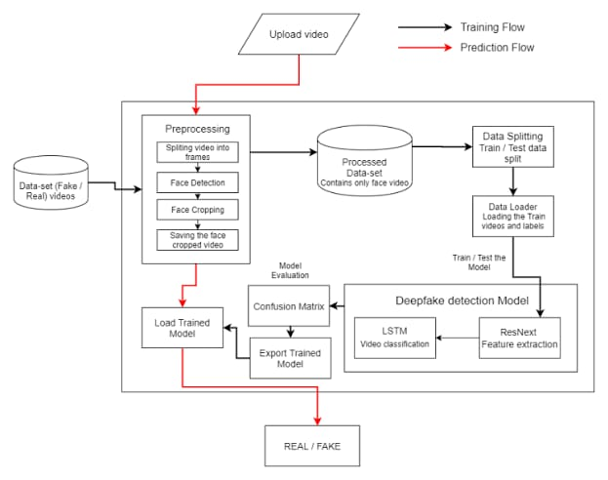
Architecture Diagram :

Slide 12
Hardware and Software Details :
Hardware requirements
GPU: NVIDIA RTX 30XX series or higher (e.g., RTX 3090, A100)
CPU: Intel i7/i9 or AMD Ryzen 7/9 series.
RAM: 32GB or more.
Storage: SSD (1TB+), optional external storage (4TB+)
Networking: High-speed internet (for cloud computing)
Software Requirements
Operating System: Linux (Ubuntu 20.04+) or Windows 10/11
Deep Learning Frameworks: Tensor Flow or PyTorch
Libraries: OpenCV (video processing),librosa (audio processing),Hugging Face Transformers (for temporal analysis),Scikit-learn (evaluation, metrics),NumPy & Pandas (data handling)
Self-Supervised Learning Libraries: SimCLR or BYOL
Data Augmentation/Pre processing: Albumentations, Speech-to-Text API
GANs: CycleGAN, StyleGAN, custom GAN implementations
Deployment: Flask/ FastAPI, Dockers
Visualization: Tensor Board, Visdom, Matplotlib, Seaborn

Slide 13
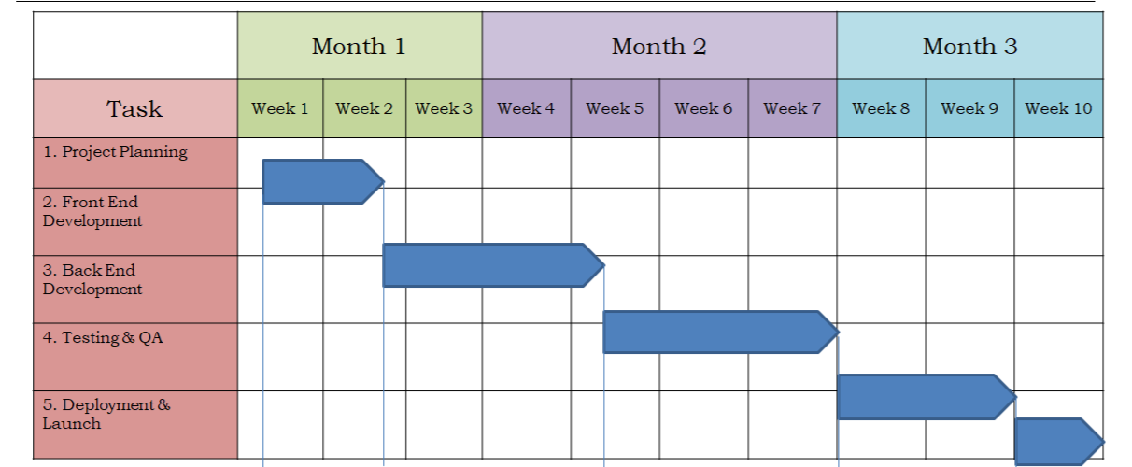
Timeline of the Project (Gantt Chart)

Slide 14
References (IEEE Paper format)
Deepak Dagar; Dinesh Kumar Vishwakarma ,A Diverse Manipulation Deepfake Video Dataset, 2020
Anis Trabelsi; Marc Michel Pic; Jean-Luc Dugelay,Improving Deepfake Detection by Mixing Top Solutions of the DFDC ,2019
Jixin Zhang; Ke Cheng; Giuliano Sovernigo; Xiaodong Lin, A Heterogeneous Feature Ensemble Learning based Deepfake Detection Method,2022
Shan Jia; Xin Li; Siwei Lyu, Model Attribution of Face-Swap Deepfake Videos,2021
Siddharth Yadav; Sahithi Bommareddy; Dinesh Kumar Vishwakarma, Robust and Generalized DeepFake Detection,2020
Qasim Jaleel; Israa Hadi Ali, Facial Behavior Analysis-Based Deepfake Video Detection using GAN Discriminator,2022
Sio Jurnalis Pipin; Ronsen Purba; Muhammad Fermi Pasha, Deepfake Video Detection Using Spatiotemporal Convolutional Network and Photo Response Non Uniformity,2021
Reva Chinchalkar; Rachita Sinha; Manish Kumar; Neeraj Chauhan; Shubhangi Deokar; Sudhanshu Gonge, Detecting Deepfakes using CNN and LSTM,2022
Lalitha S; Kavitha Sooda, DeepFake Detection Through Key Video Frame Extraction using GAN,2021

Slide 15


